Slide 1
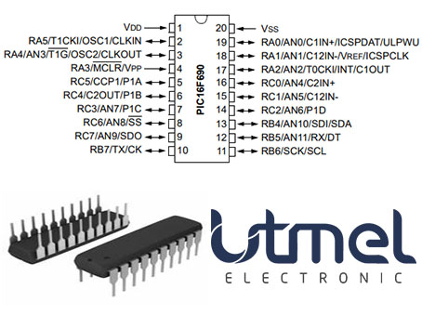
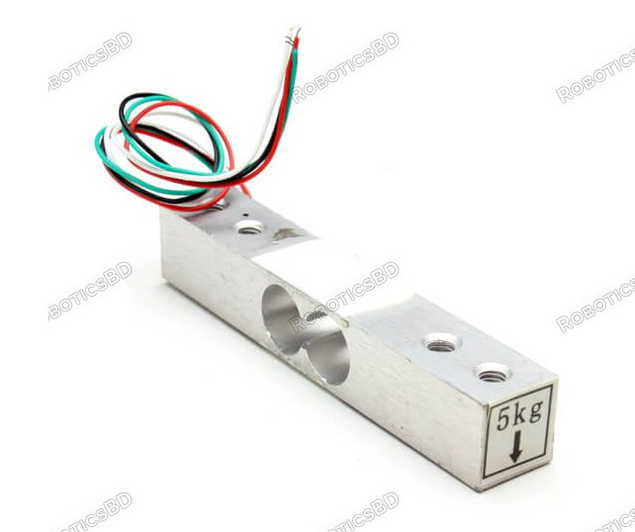
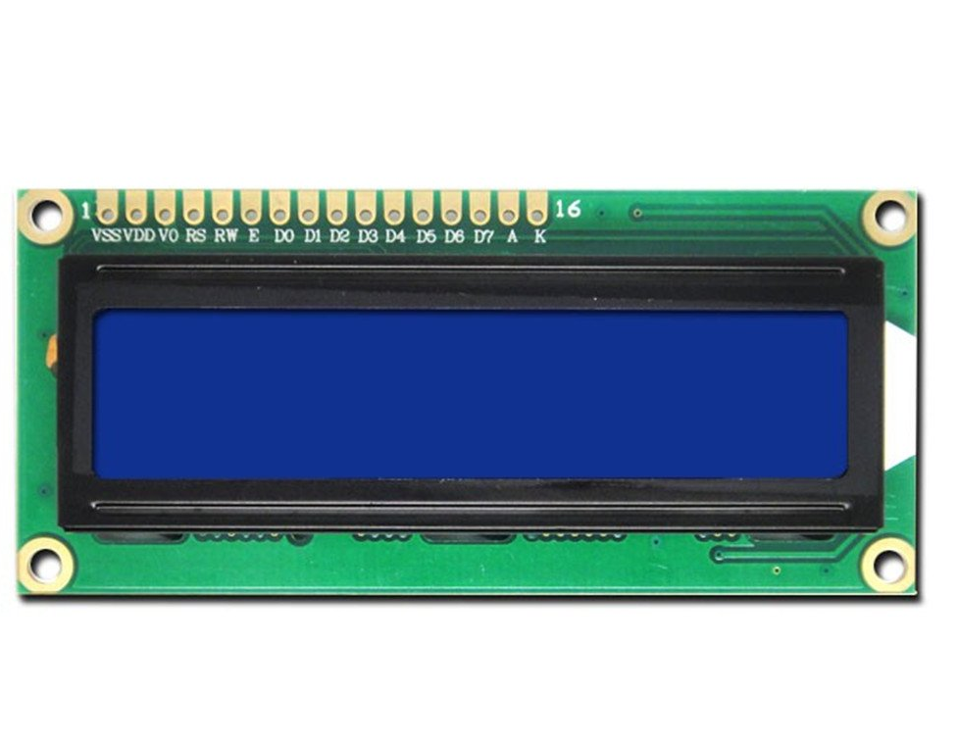
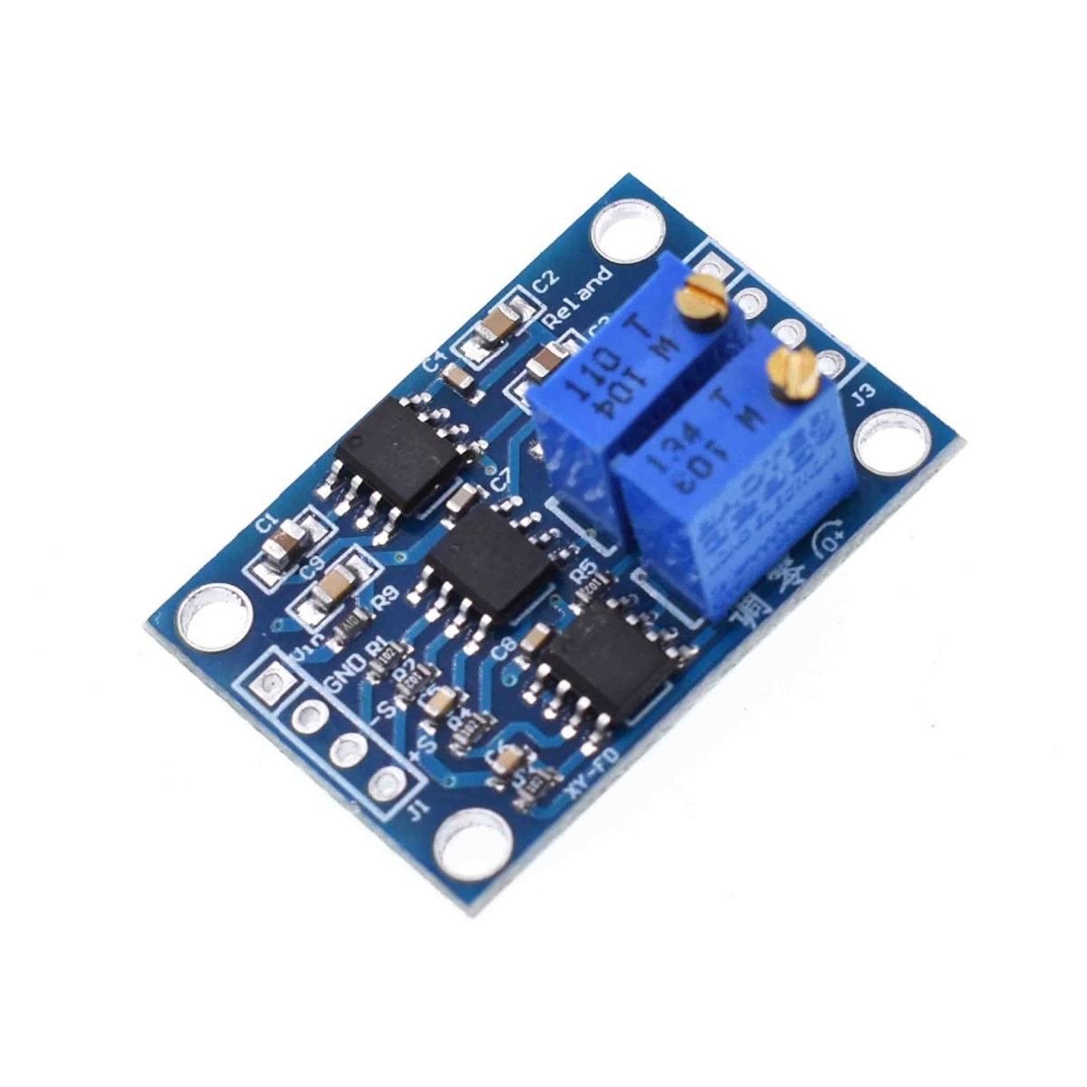
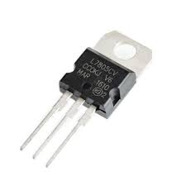


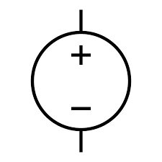
Weight Measurement Device
Submitted By: Name :Abdullah Al Rafi
ID :2020-1-80-068
Course Code : EEE435
Course : Embedded Systems
Semester : Summer2023
Submitted To: Dr. Muhammed Mazharul Islam
Assistant Professor
Department of
Electrical and Electronic Engineering
East west University, Dhaka
Objective : The Objective of the Project is to interface the PIC16F690 Microcontroller with a Load Cell (Resistive Strain Gauge) to get the output in LCD1602 Module
Instruments :
PIC16F690
Load Cell
LCD1602
[1]
[2]
[2]
AD602
LM7805
[3]
[3]

Slide 2
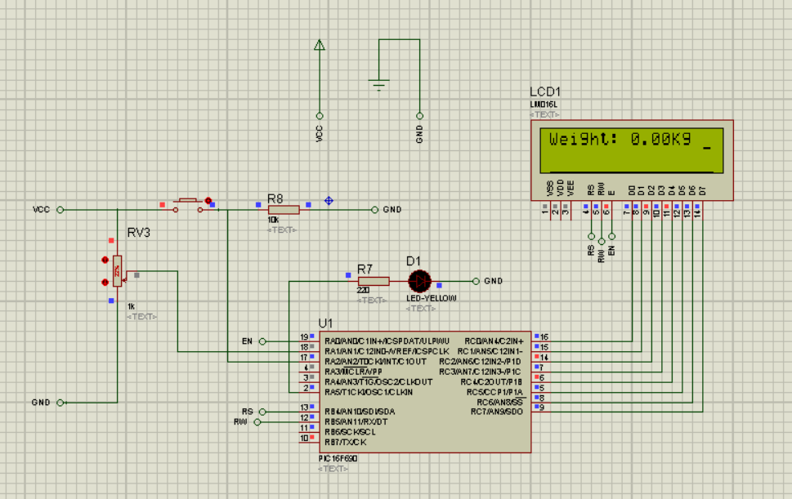
Program Flow Chart:
Mechanical input converted to electrical signal
Take Digital Input of Taring signal as external Interrupt
uV
Amplify the Signal
Run the Interrupt Service Routine and Set the Tare Flag
mV
Take the voltage as Analog Input in MCU and process with gain factor
Yes
Tare Flag Set
Offset weight at the measured Value
No
Initiate the Liquid Crystal Display and Print Values
8-bit Data
Output in the Liquid Crystal Display
Operational Features :
Measuring Weight
Taring Weight
Backlit Display (Dark Environment)
Circuit Diagram in Simulation :
[4]

Slide 3
Challenges Faced:
The Electrical Signal is in micro-volt range which is not measurable by the PIC16F690 Microcontroller
Storing the variables outside the main function was not available [5]
Display Showing Garbage Values
Physically debugging the system is time consuming [4]
Programmers are costly
Design Optimization:
AD602 Differential Amplifier used to amplify the micro-volt signal to milli-volt signal measurable by the PIC16F690
Defining another loop inside the main function to eliminate void main function reset [5]
Securing Connection of Jumper Wires
Checked the system through simulation before implementing physically [4]
Provided by the Department
Conclusion : The design works as the simulation process after physical implementation.
Moreover, the device can be further used as a Voltmeter.
References :
Images - https://techshopbd.com
Images - https://store.roboticsbd.com
Images - https://www.electronics.com.bd
Simulation software- https://www.labcenter.com
XC8 Compiler- https://www.microchip.com/en-us/tools-resources/develop/mplab-x-ide

